Slide 1

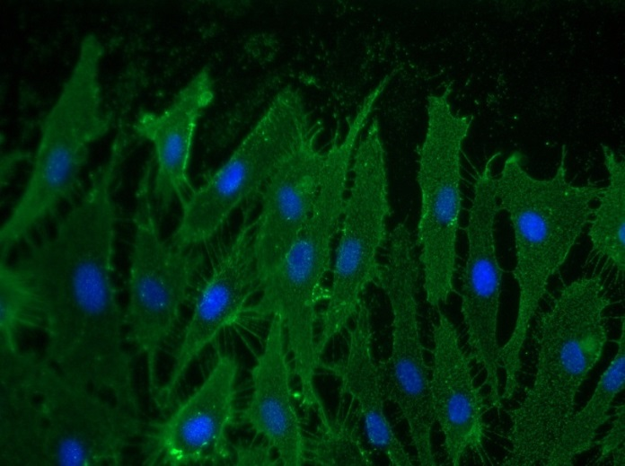
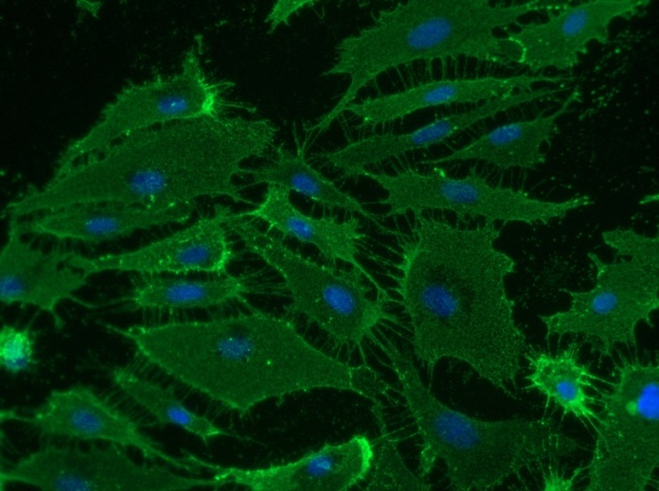
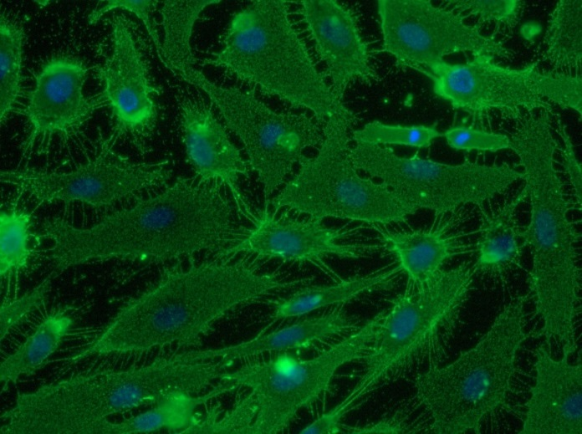
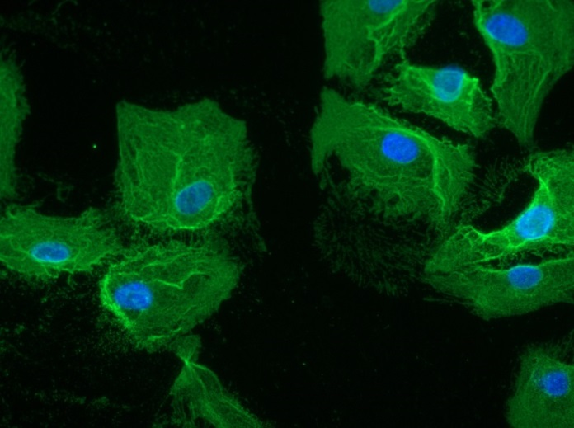
Reliatech GmbH
Rabbit anti-human CD105 / Endoglin
(Cat# 102-PA60AG)
Immunofluorescence staining of human CD105/Endoglin in primary human lymphatic endothelial cells (HDLEC) using a polyclonal rabbit anti-human CD105 (#102-PA60AG) antibody.
As secondary antibody goat anti-rabbit ALEXA Flour 488 (Dianova) was used 1:400. [IF_LEC1401-03]
.
0,5µg/ml
2µ/ml
5µg/ml
10µg/ml
http://www.reliatech.de / orders@reliatech.de

